Slide 1
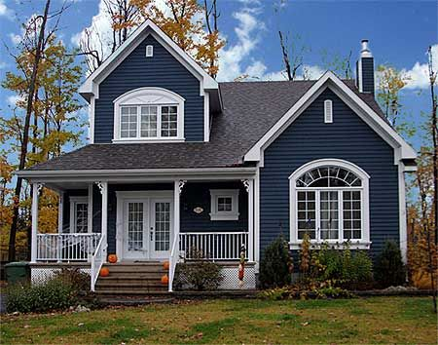
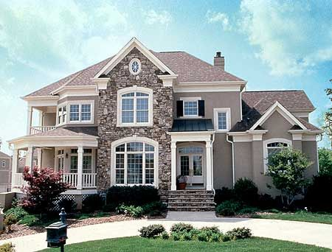
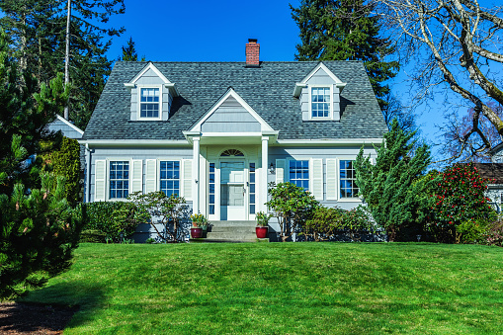
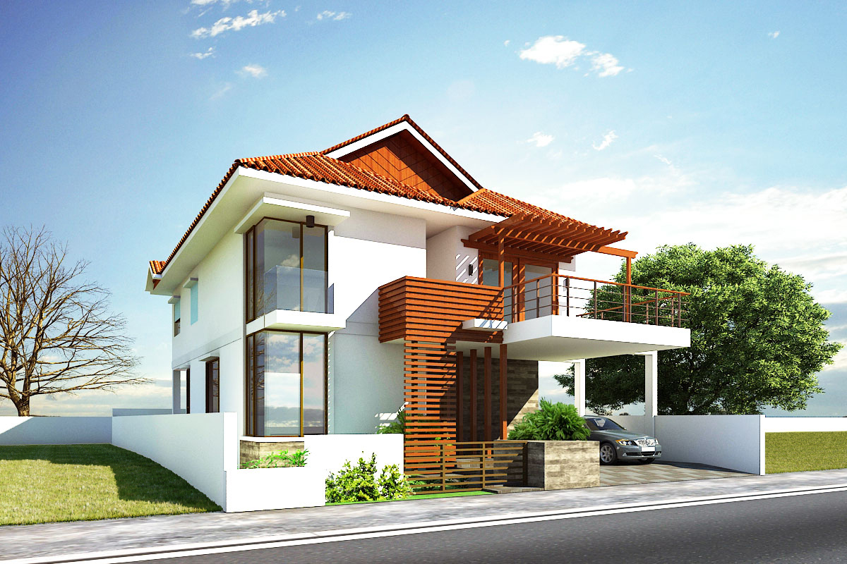
Properties you own:
2368 N 108th St, Seattle WA 98133
2567 S 56th St, Seattle WA 98103
105 SE 87th St, Seattle WA 98125
7135 N 20th St, Seattle WA 98195

Slide 2


Notification Sent
Payment Received
Receipt Sent
Monthly Rent: 1,200
Notification Sent
Payment Overdue
Receipt Sent
Monthly Rent: 2,300

Slide 3
Notification Sent
Payment Received
Receipt Sent
Monthly Rent: 1,800
Notification Sent
Payment Received
Late Fee Applied
Receipt Sent
Monthly Rent: 2,100

Slide 4
Address: 2368 N 108th St, Seattle WA 98133
Tenant Information:
Name: Anuraag Dangerous
Phone: (206) 697-45xx
Email: raagy_pants@hotmail.com
More…
Maintenance History
Payment History
Tax History

Slide 5
Address: 2567 S 56th St, Seattle WA 98103
Tenant Information:
Name: Andrea Lopez
Phone: (206) 697-45xx
Email: andrea_@hotmail.com
More…
Maintenance History
Payment History
Tax History

Slide 6
Address: 105 SE 87th St, Seattle WA 98125
Tenant Information:
Name: Lauren Lee
Phone: (206) 697-45xx
Email: lauren_lxx@gmail.com
More…
Maintenance History
Payment History
Tax History

Slide 7
Address: 7135 N 20th St, Seattle WA 98195
Tenant Information:
Name: Robert Deniro
Phone: (206) 697-45xx
Email: robby_den@gmail.com
More…
Maintenance History
Payment History
Tax History

